Slide 1

A
Learning Project-I Report
On
“TIC TAC TOE”
Submitted in partial fulfillment of
The requirements for the 3rd Semester Sessional Examination of
BACHELOR OF TECHNOLOGY
IN
COMPUTER SCIENCE & ENGINEERING
By
Sakshi Kumari Sinha(22UG010098)
Ekata Kumari(22UG010135)
Sarmistha Parija(22UG01LE19)
DEPARTMENT OF COMPUTER SCIENCE & ENGINEERING
GIET UNIVERSITY, Gunupur
2023 - 24

Slide 2
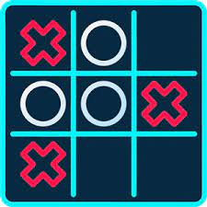
AGENDA
Abstract
Introduction​
Names
Gameplay
Objective
​Flow Diagram
Er Diagram​
Software Requirement
Hardware Requirement
Conclusion

Slide 3

Abstract
Tic Tac Toe is very simple game developed HTML CSS PHP and MYSQL.
This game consist of two players.
In This game there are 3X3 cells are present, One of the player chooses a cell of game and put X mark in the chosen cell, While Second player chooses another cell and put in zero in another cell.
This will be continue until Player One or Player Two will win
In the following example, the first player (X) wins the game in seven steps:

Slide 4
Introduction
The "Game-Zone" website aims to provide users with a platform to enjoy timeless games: Tic Tac Toe. The website will be user-friendly, attractive and accessible, catering to a diverse audience.
In addition to entertainment, the project is an educational platform. For Tic Tac Toe, it’s an opportunity to provide educational and strategic guidance to help players develop their complex ideas. Access to best practices, understanding systems, and developing decision-making capacity are inherent features of the educational scale.
The Tic Tac Toe website in C serves as a tangible portfolio piece, showcasing the developer's ability to create functional and visually appealing web applications.
It encourages problem-solving and critical thinking while fostering a deeper appreciation for the synergy between C programming and web development. Overall, this project not only entertains users with a timeless game but also equips developers with a well-rounded skill set, making it a purposeful endeavor in the realm of programming education.

Slide 5
Name
Tic Tac Toe: This is the most common and widely used name.
Noughts and Crosses: Commonly used in the United Kingdom, Australia, and many other English-speaking countries.
Three in a Row: Describing the game's objective of getting three in a row.
Xs and Os: Referring to the two symbols used in the game.

Slide 6
Game play
Duo-player mode:
The Duo-player mode allows users to challenge friends as opponents in real time.
The system ensures fast movement and immediately reflects the opponent’s move, creating
a sense of competition and communication. The social aspect of Duo-player games adds
some fun as players try to outdo each other.
Win and Accomplishments:
Tic-tac-toe is played on a three-by-three grid by two players, who alternately place the marks X and O
There is no universally agreed rule as to who plays first, but in this article the convention that X plays first
is used .
Players soon discover that the best play from both parties leads to a draw. Hence, tic-tac-toe is often
played by young children who may not have discovered the optimal strategy .

Slide 7

objective
Our primary goal is to provide a digital platform where people of all ages can play, enjoy, and learn from the timeless game of Tic Tac Toe. We aim to create an engaging, educational, and entertaining experience for users.
Online Tic Tac Toe Game
User-Friendly Interface
Accessibility
Educational Resources
Multiplayer Modes
Global Reach

Slide 8
Flowchart

Slide 9
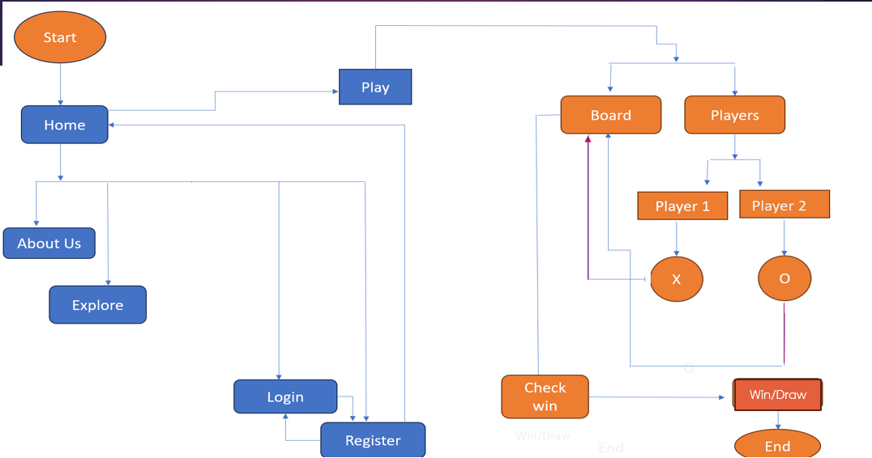

Slide 10
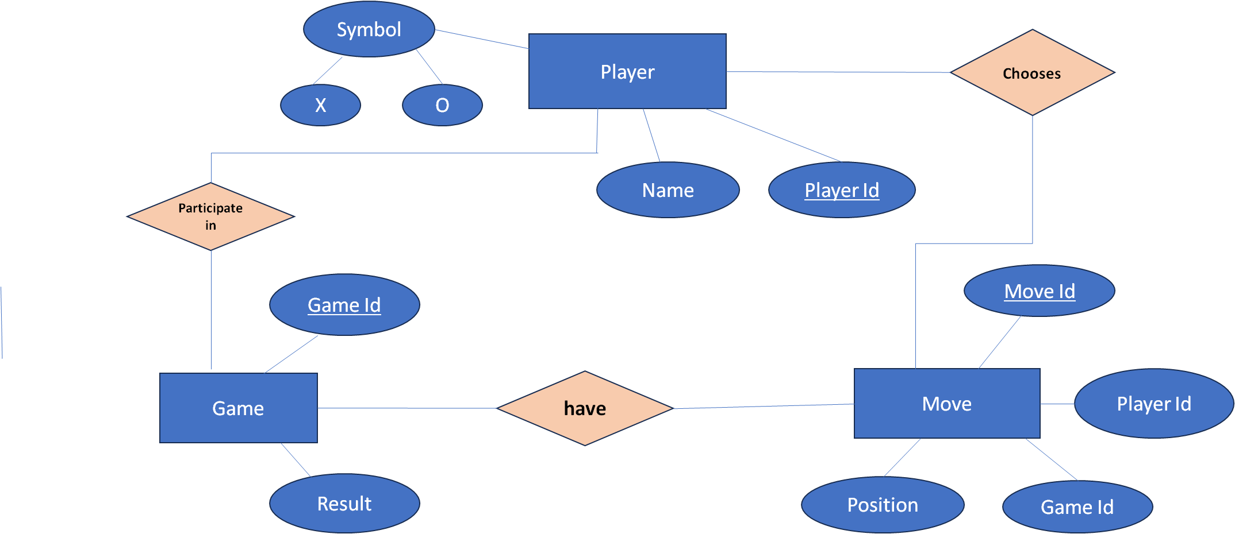
Er Diagram

Slide 11




Software requirement
C Language
Html
Css
MY sql and php

Slide 12
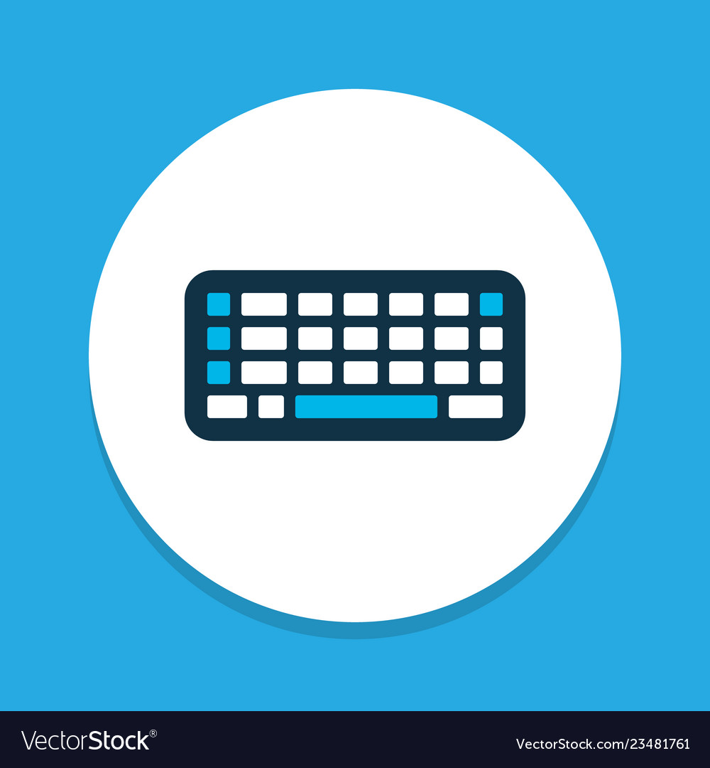


Hardware requirement
Keyboard
laptop
mouse

Slide 13
Conclusion
Tic Tac Toe website is a educational gaming platform where player can develop their stratergic thinking by playing .
Tic Tac Toe game is a cherished pastime for every age group player.
Its simplicity holds its place in the world of recreational gaming. Whether played on a piece of paper, a wooden board, or a digital screen , Tic Tac Toe captures the attention and engage players from all around the world.
Our project is all about creating a user-friendly and accessible Tic Tac Toe website that caters to a diverse audience.

Slide 14


